Slide 1
Lecture 5: CNN: Regularization
boris. ginzburg@intel.com

Slide 2
Agenda
Data augmentation
Dropout (Hinton et al )
Stochastic pooling (Zeiler, Fergus)
Maxout (I.Goodfellow)

Slide 3
Overfitting
Alexnet has 60 mln parameters.
Dataset: 1000 classes, 1.5 mln images, 50K validating 150K testing.
How to reduce over-fitting?
The easiest and most common method to reduce over-fitting on image data is to artificially enlarge the dataset using label-preserving transformations:
generating image translations and horizontal reflections
altering the intensities of the RGB channels in training images
Elastic deformation (Simard, 2003)

Slide 4
Alexnet: Dropout
Technique proposed by Hinton et al. See : http://www.cs.toronto.edu/~fritz/absps/imagenet.pdf
Dropout was used for training of fully connected layers.
Training:
setting to 0 the output of each hidden neuron with probability 0.5. The neurons which are “dropped out” in this way do not contribute to the forward pass and do not participate in back-propagation. So every time an input is presented, the neural network samples a different architecture, but all these architectures share weights.
Test:
At test time, we use all the neurons but multiply their outputs by 0.5.
Caffe: implemented as “dropout layer”

Slide 5
Learning rate and dropout
“Optimization proceeds very differently when using dropout than when using ordinary stochastic gradient descent. SGD usually works best with a small learning rate that results in a smoothly decreasing objective function, while dropout works best with a large learning rate, resulting in a constantly fluctuating objective function. Dropout rapidly explores many different directions and rejects the ones that worsen performance, while SGD moves slowly and steadily in the most promising direction.”
http://arxiv.org/pdf/1302.4389.pdf

Slide 6
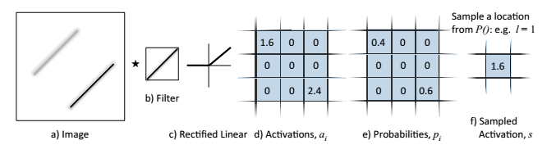
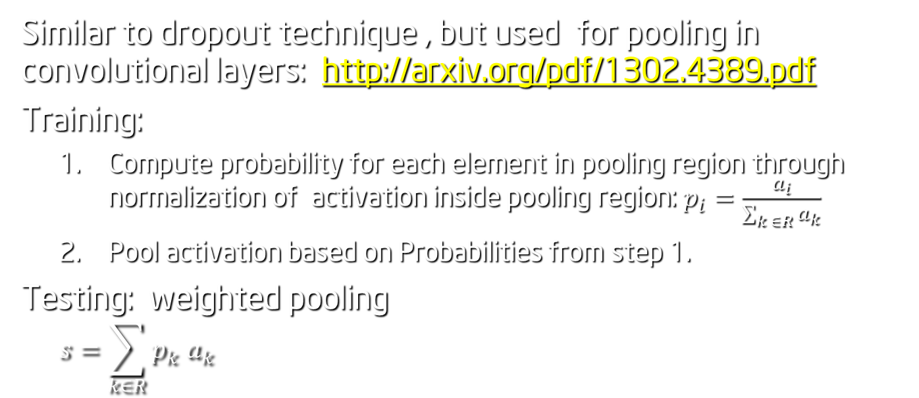
Zeiler & Fergus: Stochastic Pooling
Similar to dropout technique , but used for pooling in convolutional layers: http://arxiv.org/pdf/1302.4389.pdf
Training:
Compute probability for each element in pooling region through normalization of activation inside pooling region: $p_{i}=\frac{a_{i}}{\sum_{k ∈R}{a_{k}}}$
Pool activation based on Probabilities from step 1.
Testing: weighted pooling
$$s=\sum_{k∈R}{p_{k} a_{k}}$$

Slide 7
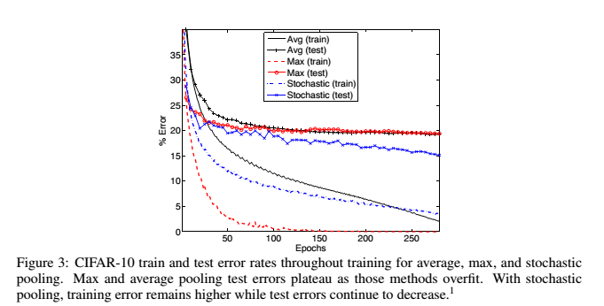
Zeiler & Fergus: Stochastic Pooling

Slide 8
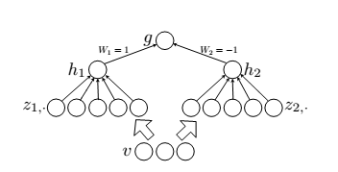

Goodfellow: Maxout
http://www-etud.iro.umontreal.ca/~goodfeli/maxout.html
In a convolutional network, a maxout feature map can be constructed by taking the maximum across k affine feature maps (i.e., pool across channels, in addition spatial locations)
$h_{i}=\max_{j=1..M}{∗z_{ij}}$ = $\max_{j=1..M} ({w_{ij}}∗ v_{j}+b_{ij}$)

Slide 9
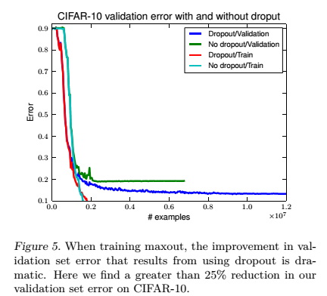
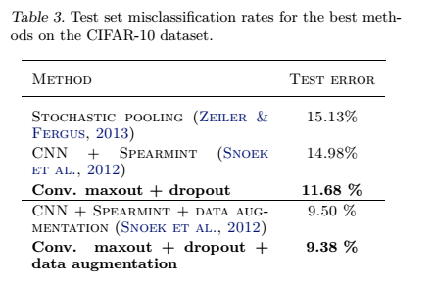
Maxout results

Slide 10
Exercises
CIFAR-10 - experiment with Dropout layer
Implement Stochastic pooling and Max-out layers

